Slide 1
2021-22 fafsa.gov preview presentation
September 2020
Notes:
2021-22 title slide.

Slide 2
Topics
Overview
Home view
Login view
Dependent Student with Parental Data view
Independent Student view
My FAFSA views
SAR view
FAFSA® Corrections view
Auto-Zero EFC (skipping the remaining financial questions) view
Special Circumstances view
Special Circumstance – Unsubsidized Loan Only view
Homeless Circumstance view
Additional Resources view
Additional Resources
Notes:
2021-22 Topics slide.

Slide 3
Overview
The 2021-22 fafsa.gov preview presentation provides screenshots that financial aid professionals, mentors, and counselors can use as a guide for the 2021-22 fafsa.gov application. The screenshots and information provided can be used to create/modify presentations for professional trainings and high school nights.
The screenshots are intended to show the majority of the questions displayed in fafsa.gov; however, most applicants and/or parents are unlikely to need to answer all of the questions when completing their application.
The screenshots used in this presentation shows examples of what fafsa.gov will look like.
Notes:
2021-22 Overview slide.

Slide 4
Overview (continued, part 1)
The 2021-22 version of fafsa.gov will be available for applicants to use on October 1, 2020.
The 2021-22 fafsa.gov web demonstration site will be available on September 27, 2020.
Notes:
2021-22 Overview slide continued part 1.

Slide 5
Overview (continued, part 2)
The following are key features of fafsa.gov:
  Students and parents may begin, complete, and submit a new or renewal FAFSA form for the 2021–22 FAFSA® form processing cycle.
  Students and parents who are eligible may use the IRS Data Retrieval Tool (IRS DRT) to electronically transfer federal tax return information into a FAFSA form.
  Students and parents may be eligible to transfer their FAFSA information into their state aid application. Participating states include Iowa, Minnesota, Mississippi, New Jersey, New York, Pennsylvania, and Vermont.
  Parents that have multiple students who need to file an application may be eligible to transfer their FAFSA information into a new application from the original student’s confirmation page.
  Students will be able to view additional information about the schools they selected on their FAFSA form for easy comparison of schools.
  Students and parents have the ability to correct or update an application once it’s been processed.
  Students and parents can save an application from fafsa.gov and resume where they left off on the mobile app and vice versa.
Notes:
2021-22 Overview slide continued part 2.

Slide 6
Home View page
Home view
Notes:
2021-22 Home title slide.

Slide 7
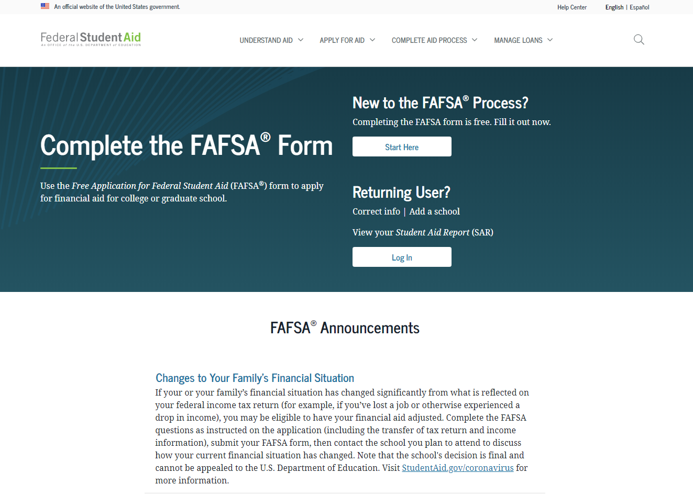
FAFSA.gov Homepage – Top Section
Notes:
2021-22 fafsa.gov home view.
The fafsa.gov home view features a two-button login option and current announcements, as well as an easy-access tool bar, featuring links to applying for aid and loan information.

Slide 8
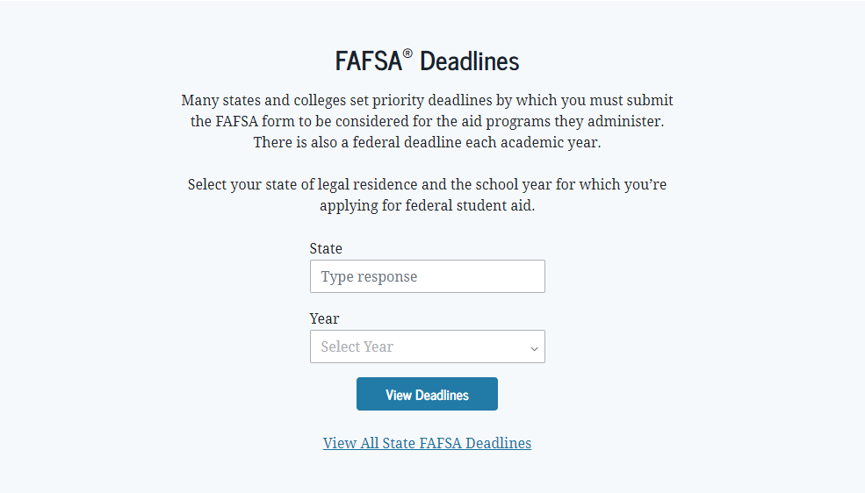
FAFSA.gov Homepage – Middle Section
Notes:
2021-22 fafsa.gov home view continued.
The fafsa.gov home view features a link to the student aid deadline search function that is available by state and cycle year.

Slide 9
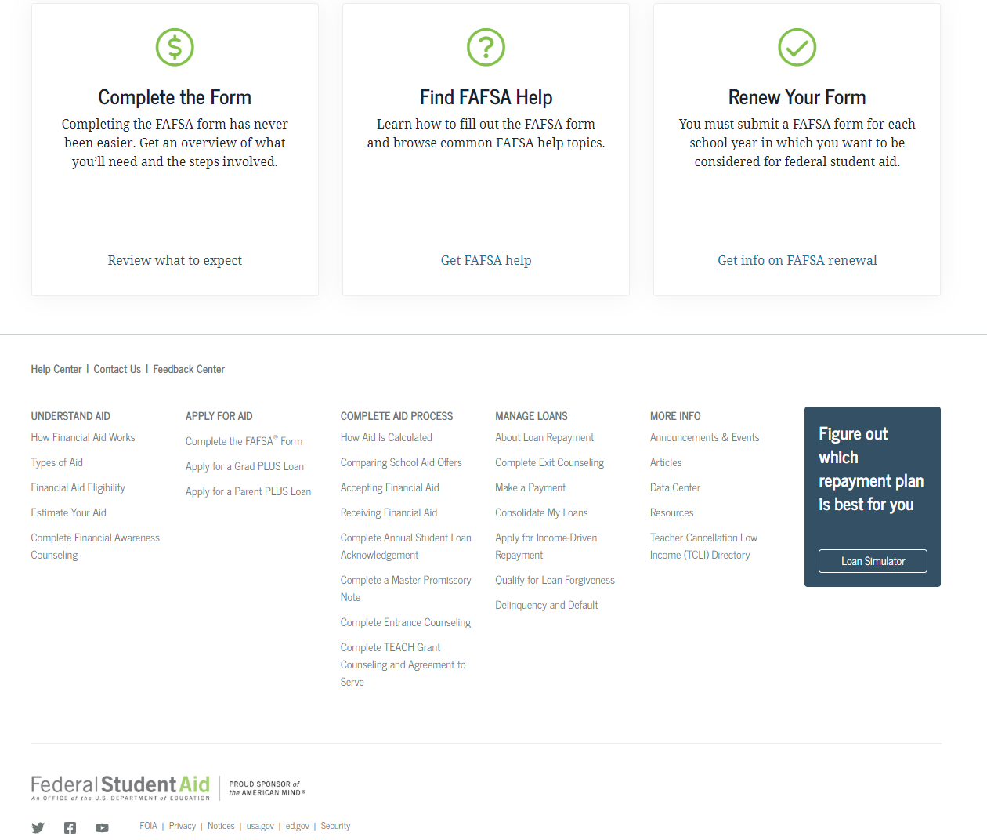
FAFSA.gov Homepage – bottom Section
Notes:
2021-22 fafsa.gov home view continued-2.
The fafsa.gov home view features three links to help users navigate the financial aid process including completing the form, FAFSA help view, and information on FAFSA renewal.
Additional Studentaid.gov links are also provided at the bottom of the homepage.

Slide 10
Login Title page
Login
Notes:
Login title slide.

Slide 11
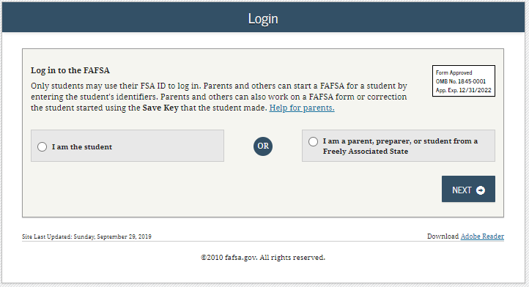
Login
Notes:
2021-22 “Login” view.

Slide 12
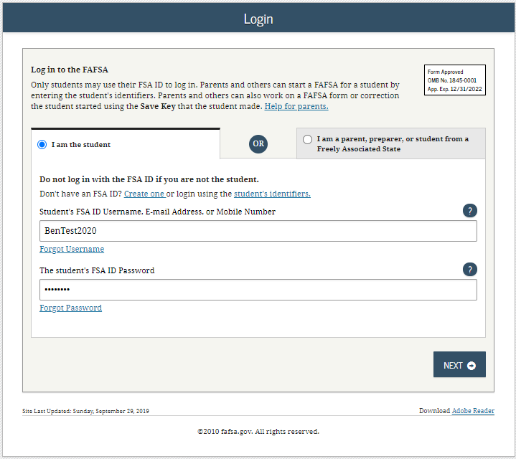
Login – I am the Student
Notes:
2021-22 “Login” view with the “I am the student” option selected.
Note: If using this option, the applicant can choose one of three ways to log in to the application: using an FSA ID, a verified email address, or a verified phone number.

Slide 13
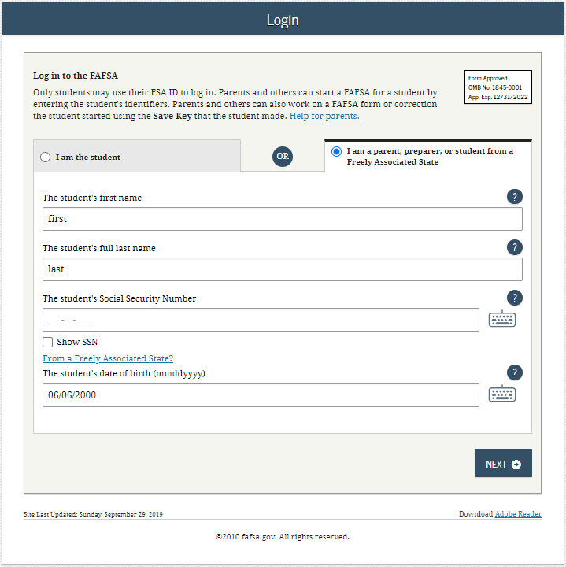
Login – I am a parent, preparer, or student from a Freely Associated State
Notes:
2021-22 “Login” view with the “I am a parent, preparer, or student from a Freely Associated State” option selected.
The SSN is masked by default and users have the ability to check the “Show SSN” box if they wish to see what is being typed in.

Slide 14
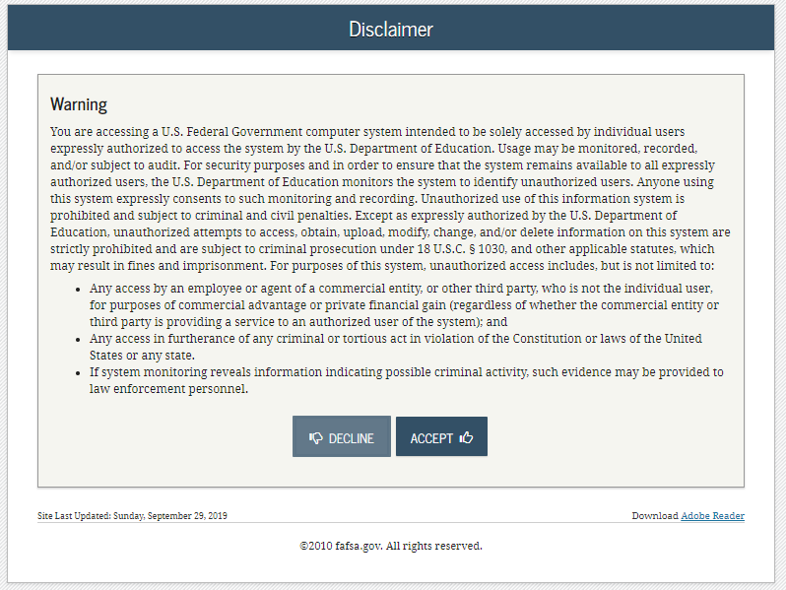
Disclaimer
Notes:
2021-22 “Disclaimer” view.

Slide 15
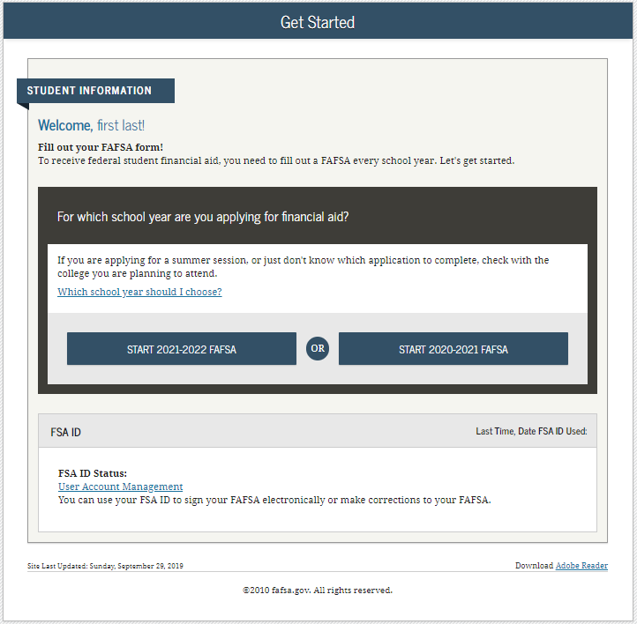
Get Started
Notes:
2021-22 “Get Started” view.

Slide 16
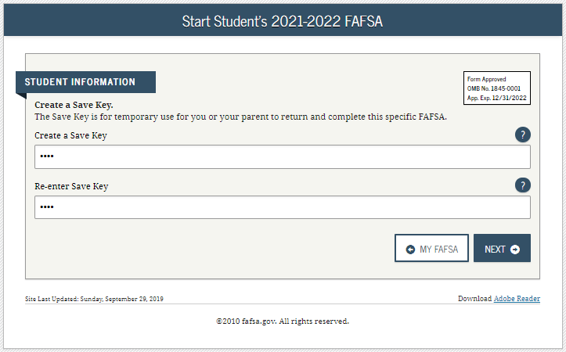
Create a Save Key
Notes:
2021-22 “Create a Save Key” view.
The Save Key allows an applicant to save their Free Application for Federal Student Aid (FAFSA®) form and return at a later time to complete and submit the application. The application is saved for 45 days, unless the applicant submits their application for processing prior to that. Additionally, the Save Key provides applicants a way to share access to their FAFSA form or correction if their parent(s) needs to add information or sign it.

Slide 17
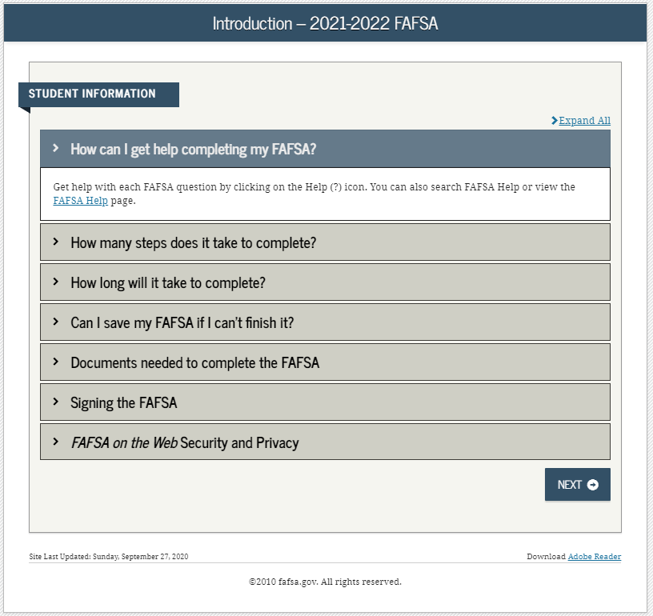
Introduction
Notes:
2021-22 “Introduction” view.
Each topic has accordion functionality that can be expanded and contracted to reveal or conceal additional information.

Slide 18
Dependent Student with Parental Data
Dependent Student with Parental Data
Notes:
Dependent Student with Parental Data title slide – logged in as an applicant.

Slide 19
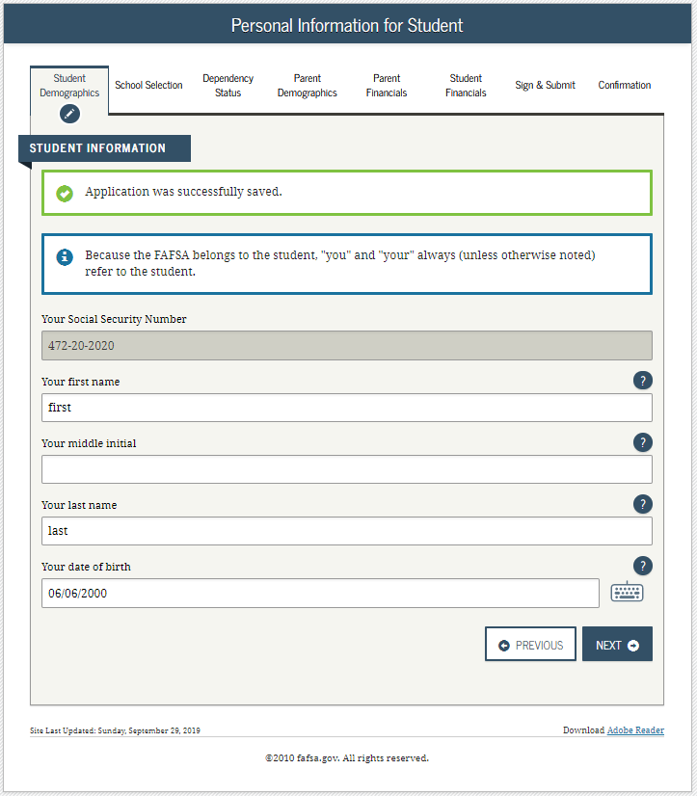
Dependent Student– Student Demographics
Notes:
2021-22 “Personal Information for Student” view.
This is one of multiple pages on fafsa.gov that explains that “you” and “your” are referencing the applicant. Other pages where this messaging appears includes the Search for High School, Student Marital Status, Parent Marital Status, and Student Tax Filing Status.
The box highlighted in green indicates that the application has been successfully saved.
Note: This is the first view for the Student Demographics section.

Slide 20
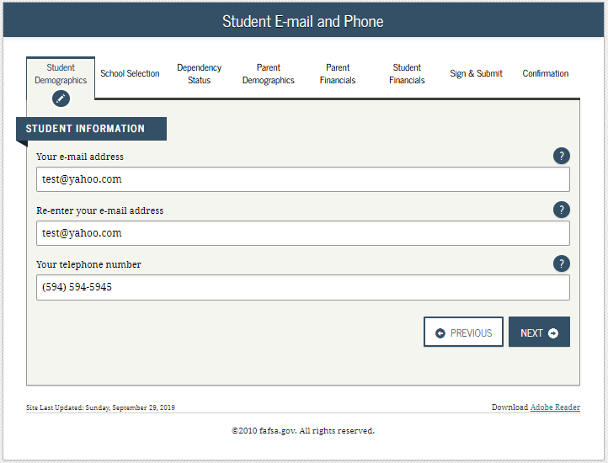
Dependent Student – Student E-mail and Phone
Notes:
2021-22 “Student E-mail and Phone” view.
Note: While not mandatory, it is beneficial for the applicant/parent to include an e-mail address on the FAFSA form in order to receive important communications about their financial aid.

Slide 21
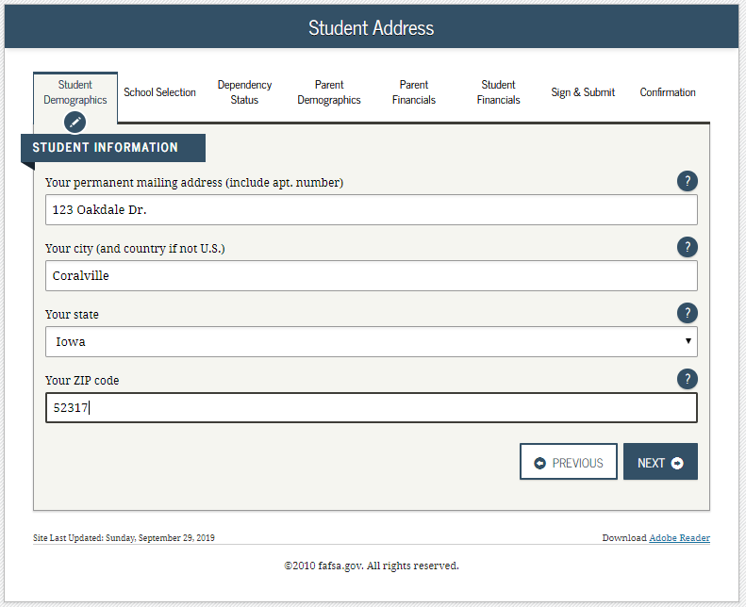
Dependent Student – Student Address
Notes:
2021-22 “Student Address” view.

Slide 22
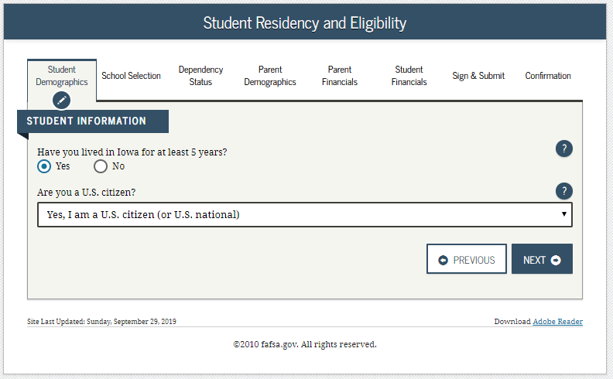
Dependent Student – Student Residency and Eligibility
Notes:
2021-22 “Student Residency and Eligibility” view.

Slide 23
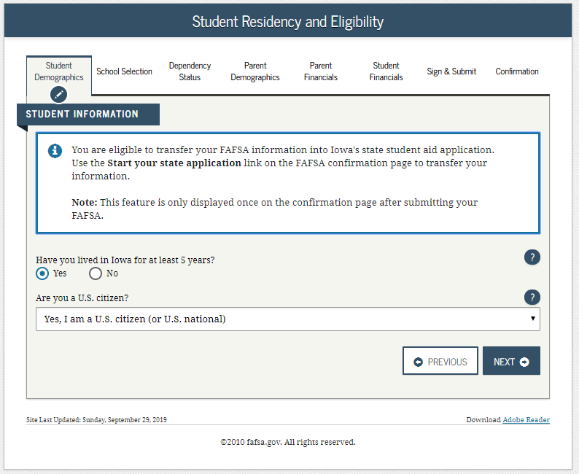
Dependent Student – State Aid Eligibility
Notes:
2021-22 “Student Residency and Eligibility” view continued.
The informational message displays to notify the applicant that they are eligible to transfer their FAFSA information to their participating state aid application. The link will be available on the FAFSA confirmation page. This message will only display when the applicant indicates a participating state as their state of legal residence.
Participating states include: Iowa, Minnesota, Mississippi, New York, New Jersey, Pennsylvania, and Vermont.

Slide 24
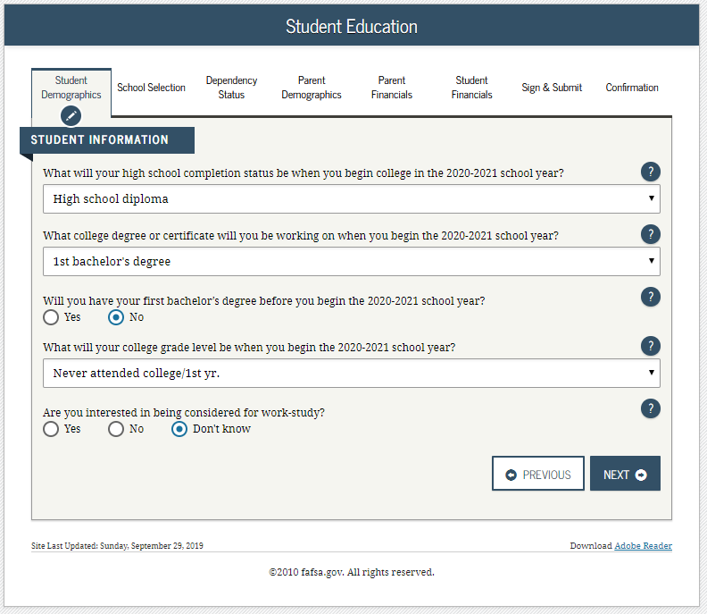
Dependent Student – Student Education
Notes:
2021-22 “Student Education” view.

Slide 25
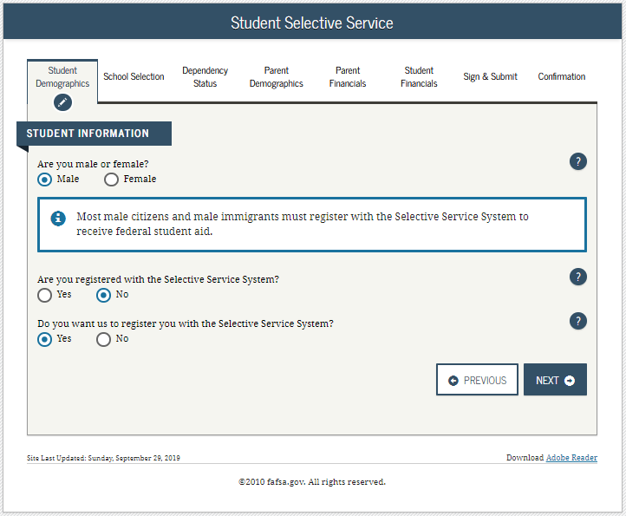
Dependent Student – Student Selective Service
Notes:
2021-22 “Student Selective Service” view.
Note: The response to this question is used to determine if the applicant needs to register with the Selective Service System (SSS). Most male citizens and male immigrants between the ages of 18–25 must register with the SSS to receive federal student aid. This requirement applies to any person assigned the sex of male at birth.

Slide 26
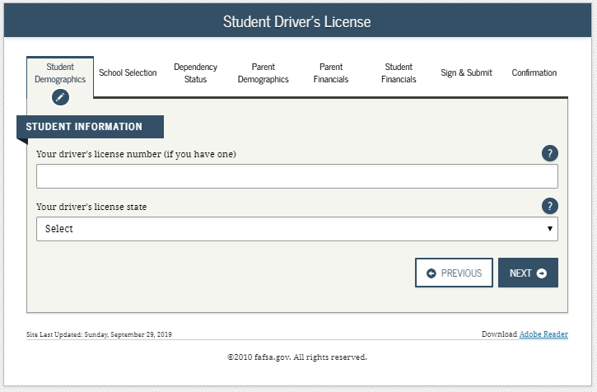
Dependent Student – Student Driver’s License
Notes:
2021-22 “Student Driver’s License” view.

Slide 27
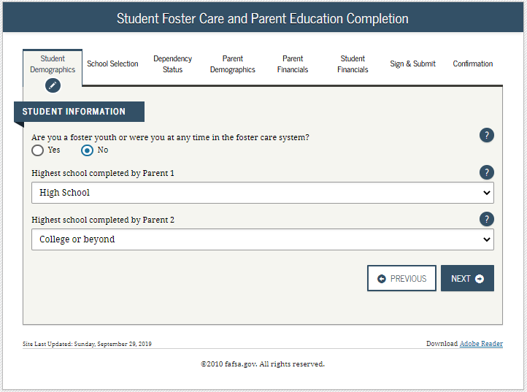
Dependent Student – Student Foster Care
Notes:
2021-22 “Student Foster Care and Parent Education Completion” view.

Slide 28
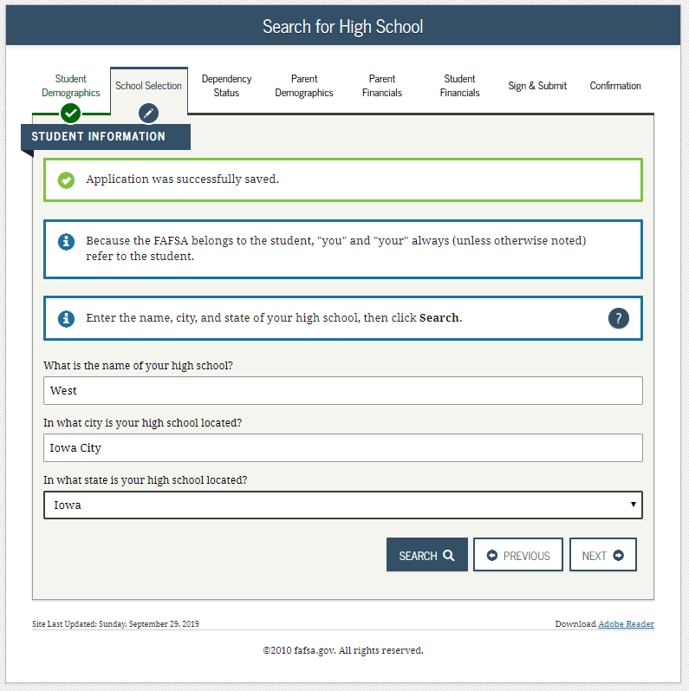
Dependent Student – Student HS Search
Notes:
2021-22 “Search for High School” view.
Note: This is the first page for the School Selection section.

Slide 29
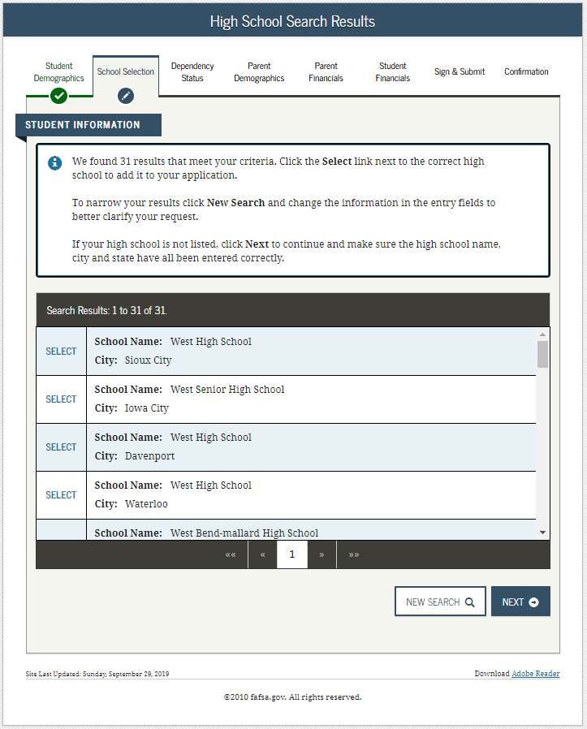
Dependent Student – Student HS Search Results
Notes:
2021-22 “High School Search Results” view.

Slide 30
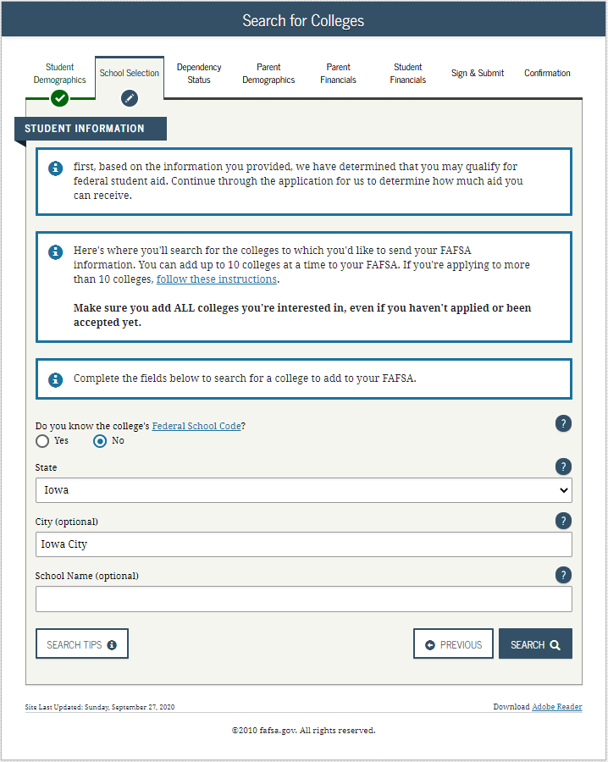
Dependent Student – Student Search for Colleges
Notes:
2021-22 “Search for Colleges” view.

Slide 31
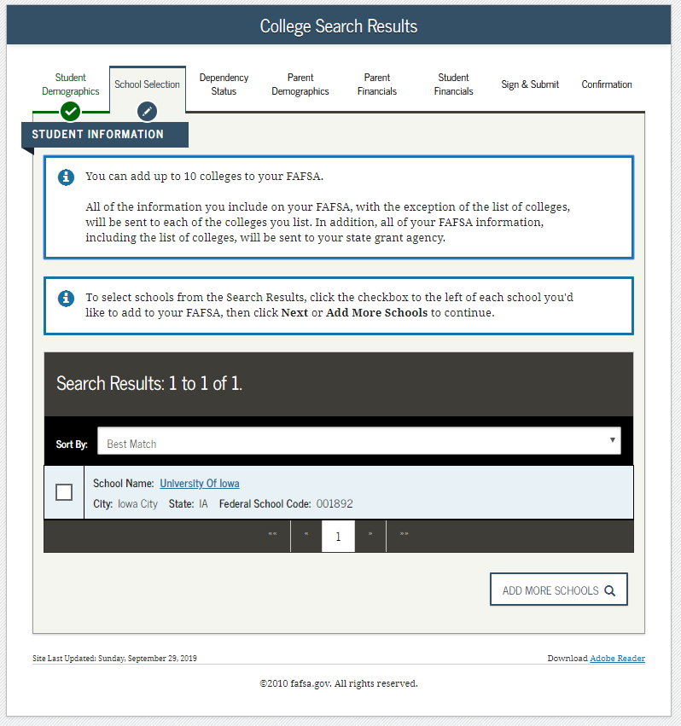
Dependent Student – Student Search for Colleges Results
Notes:
2021-22 “College Search Results” view.

Slide 32
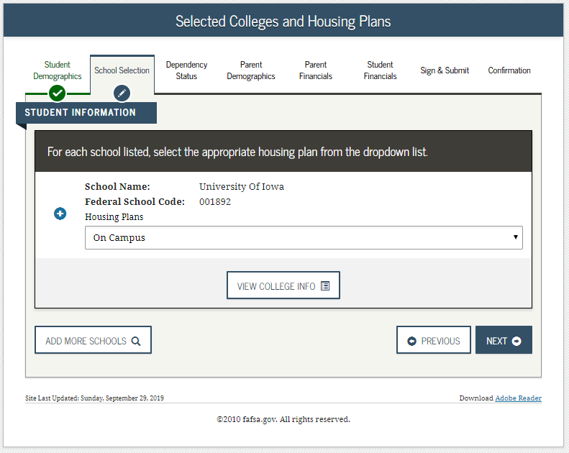
Dependent Student – Student Housing Plans
Notes:
2021-22 “Selected Colleges and Housing Plans” view.

Slide 33
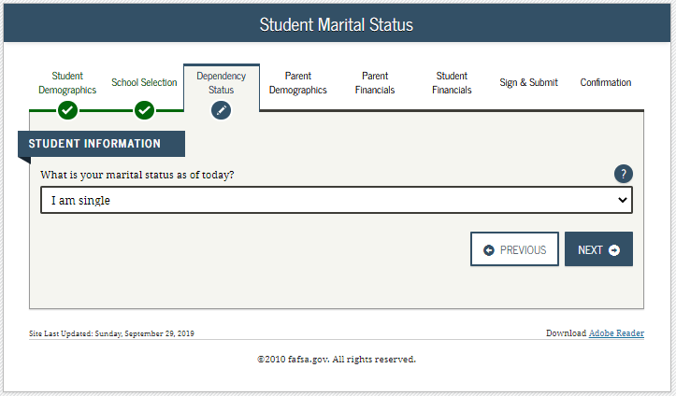
Dependent Student – Student Marital Status
Notes:
2021-22 “Student Marital Status” view.
Note: This is the first page of the Dependency Status section.

Slide 34
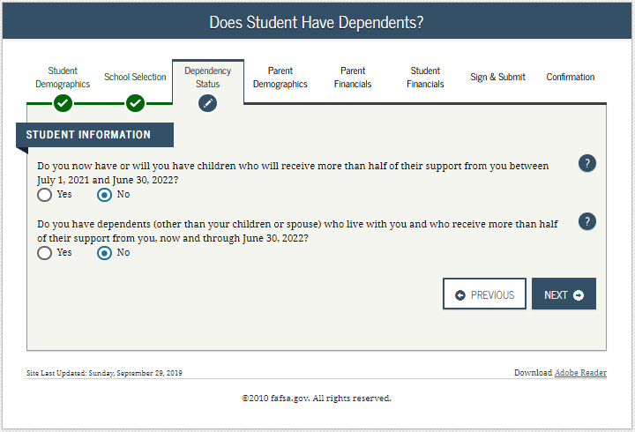
Dependent Student – Student Dependency Status 1
Notes:
2021-22 “Does Student Have Dependents?” view.

Slide 35
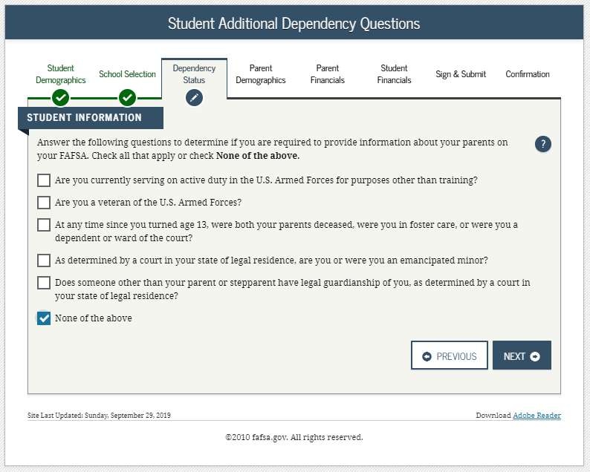
Dependent Student – Provide Parent Information 1
Notes:
2021-22 “Student Additional Dependency Questions” view.

Slide 36
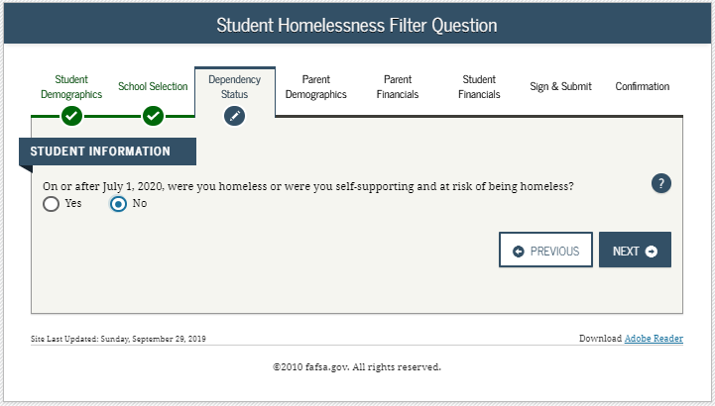
Dependent Student – Provide Parent Information 2
Notes:
2021-22 “Student Homelessness Filter Question” view.

Slide 37
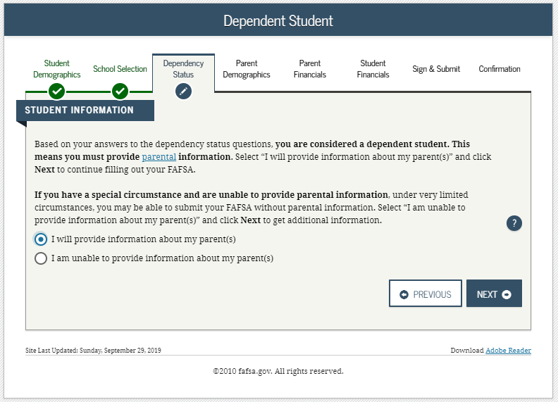
Dependent Student – Provide Parent Information 3
Notes:
2021-22 “Dependent Student” view.
This page only displays if it has been determined that the applicant is considered to be dependent.

Slide 38
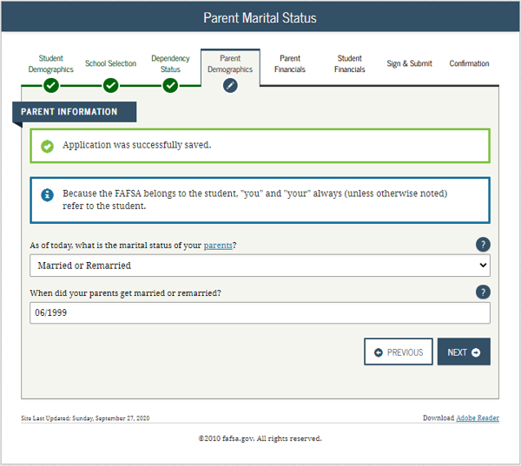
Dependent Student – Parent marital Status
Notes:
2021-22 “Parent Marital Status” view.
Note: This is the first view in the Parent Demographics section.

Slide 39
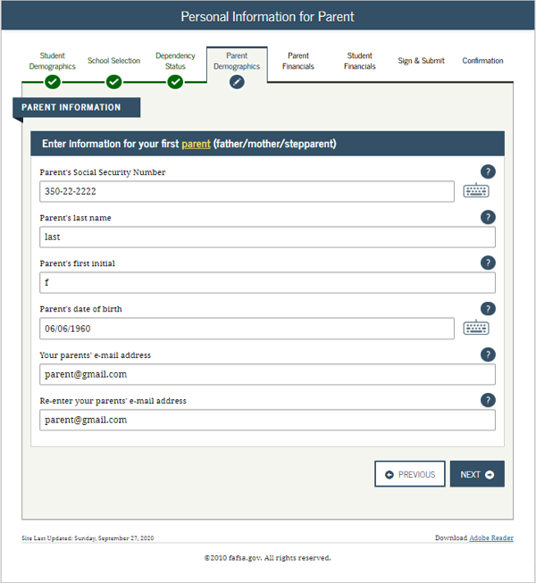
Dependent student – Personal information for parent
Notes:
2021-22 “Personal Information for Parent” view.

Slide 40
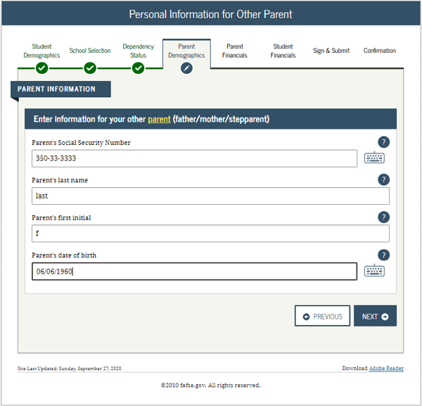
Dependent student – personal information for other parent
Notes:
2021-22 “Personal Information for Other Parent” view.

Slide 41
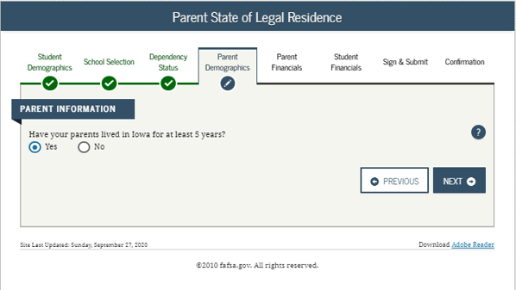
Dependent student – parent state of legal residence
Notes:
2021-22 “Parent State of Legal Residence” view.

Slide 42
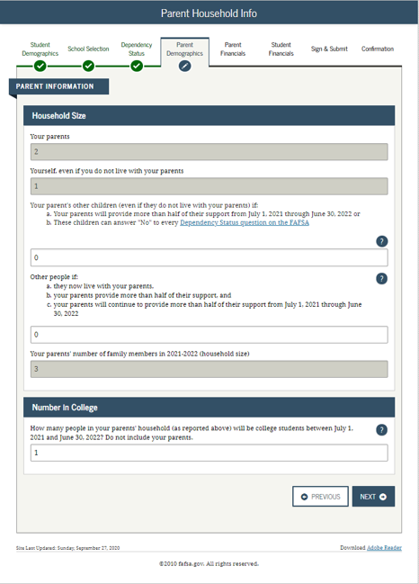
Dependent student – parent household info
Notes:
2021-22 “Parent Household Info” view.
Parents are required to complete the household size worksheet in an effort to get more accurate information about the number in the parent’s household and the number of those in the household who are in college. Some information will be prefilled, based on responses provided previously within the FAFSA form. The system tallies the totals as the parent completes the worksheet to ensure that there are no mathematical errors.

Slide 43
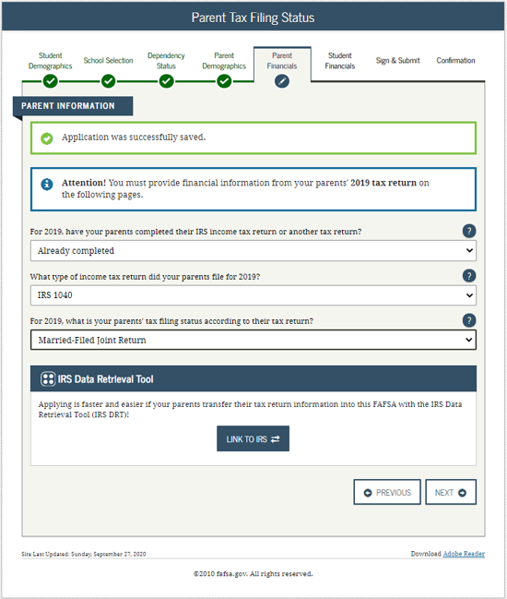
Dependent student – parent tax filing status
Notes:
2021-22 “Parent Tax Filing Status” view.
Note: This is the first view in the Parent Financials section.

Slide 44
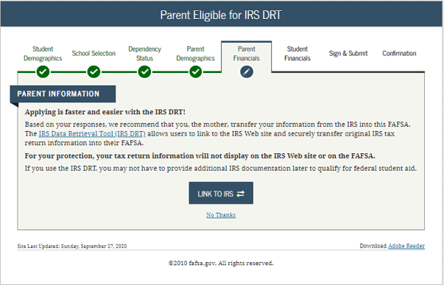
Dependent student – parent eligible for irs drt
Notes:
2021-22 “Parent Eligible for IRS DRT” view.
This view is displayed when the parent chooses not to use the IRS Data Retrieval Tool (DRT) on the previous view. An additional opportunity is presented to the parent to determine if they would like to link to the IRS for their financial information or to continue to enter it manually.

Slide 45
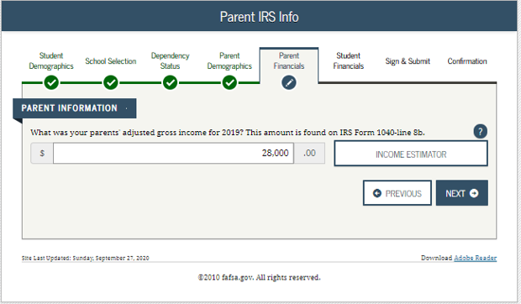
Dependent student – parent irs info
Notes:
2021-22 “Parent IRS Info” view.
Note: If the parent is either ineligible or decides not to use the IRS DRT, they will be required to enter their financial information manually.

Slide 46
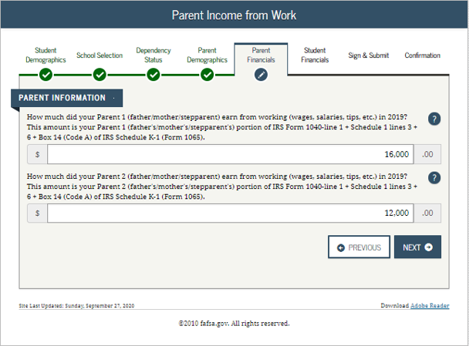
Dependent student – parent income from work
Notes:
2021-22 “Parent Income from Work” view.

Slide 47
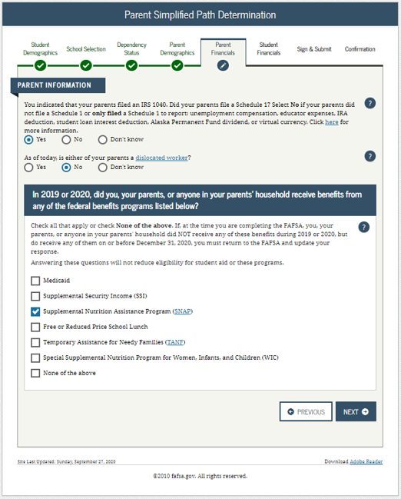
Dependent student – parent simplified path determination
Notes:
2021-22 “Parent Simplified Path Determination” view.
Instructional text will be dynamic based on the response to Parent Tax Return Status. In this example, the parent stated they “already filed” and “filed a 1040” in order to create the condition for schedule 1 dynamic text to display.
Note: The Schedule 1 question and associated help text have been updated to include all of the exceptions to answering this question. For the 21-22 cycle, capital gains and losses have been removed from the list of exceptions; reporting of virtual currency has been added.
In addition, the Schedule 1 question is now a field that can be transferred from the IRS DRT.
The Schedule 1 question may or may not be enabled based on previously answered questions.

Slide 48
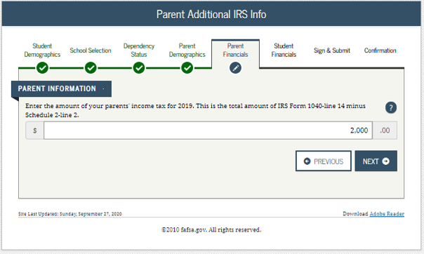
Dependent student – parent additional irs info
Notes:
2021-22 “Parent Additional IRS Info” view.

Slide 49
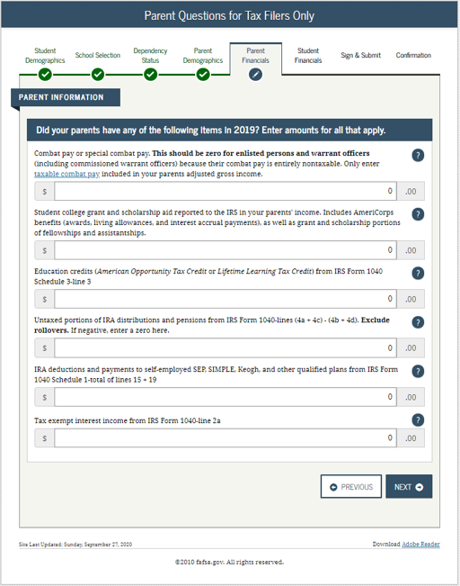
Dependent student – parent questions for tax filers only
Notes:
2021-22 “Parent Questions for Tax Filers Only” view.

Slide 50
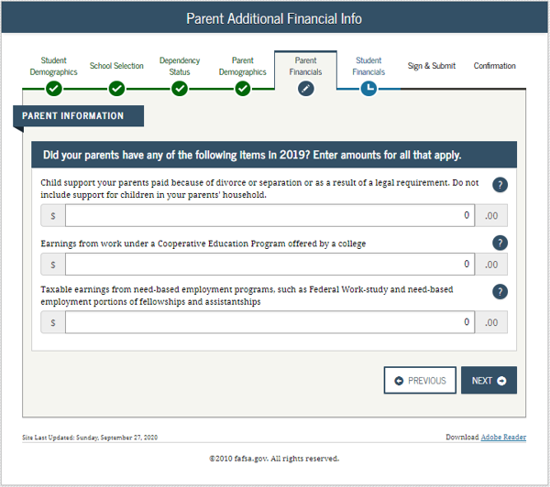
Dependent student – parent additional financial info
Notes:
2021-22 “Parent Additional Financial Info” view.

Slide 51
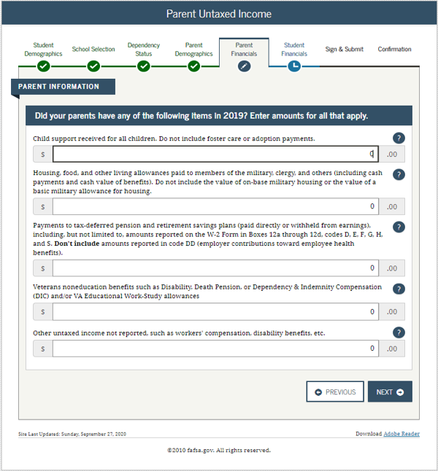
Dependent student – parent untaxed income
Notes:
2021-22 “Parent Untaxed Income” view.

Slide 52
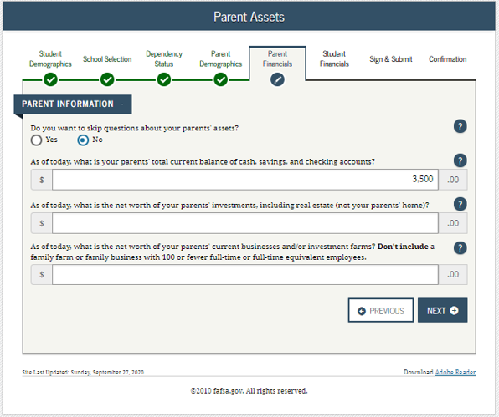
Dependent student – parent assets
Notes:
2021-22 “Parent Assets” view.
Note: Since the parents meet the simplified needs path determination criteria, the assets questions are optional.

Slide 53
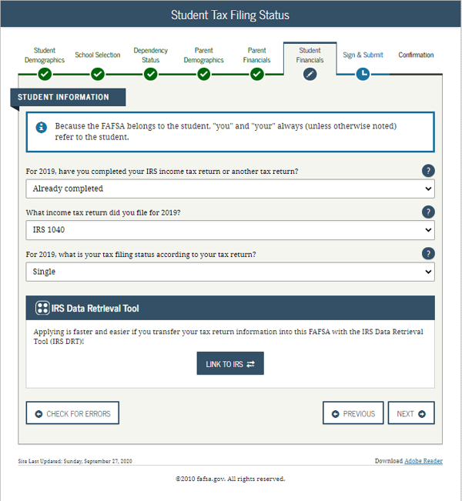
Dependent student- student tax filing status
Notes:
2021-22 “Student Tax Filing Status” view.

Slide 54
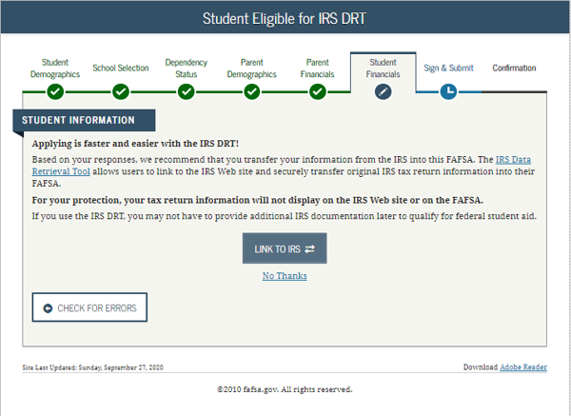
Dependent Student- Student Eligible for irs drt
Notes:
2021-22 “Student Eligible for IRS DRT” view.
This view is displayed when the applicant chooses not to use the IRS Data Retrieval Tool (DRT) on the previous view. An additional opportunity is presented to the applicant to determine if they would like to link to the IRS for their financial information or to continue to enter it manually.

Slide 55
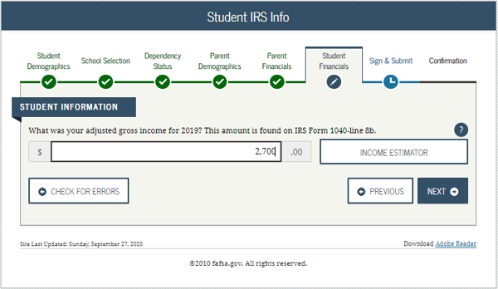
Dependent student- student irs info
Notes:
2021-22 “Student IRS Info” view.
Note: If the applicant is either ineligible or decides not to use the IRS DRT, they will be required to enter their financial information manually.

Slide 56
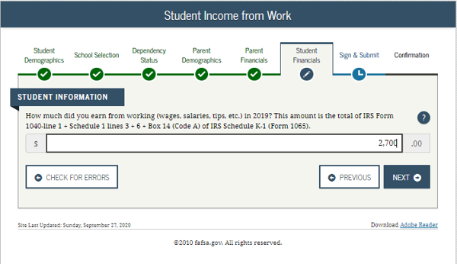
Dependent student- student income from work
Notes:
2021-22 “Student Income from Work” view.

Slide 57
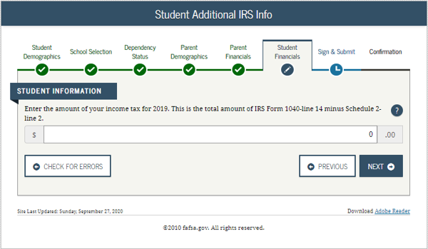
Dependent student- student additional irs info
Notes:
2021-22 “Student Additional IRS Info” view.

Slide 58
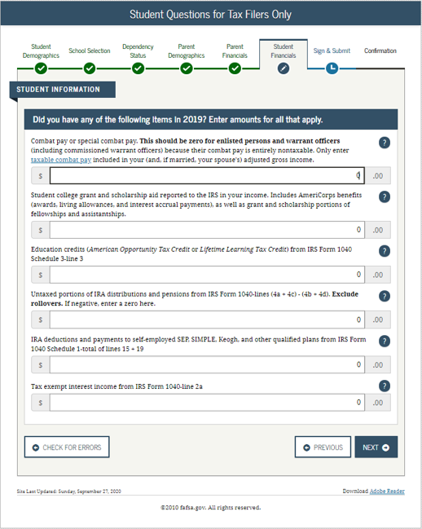
Dependent student- student questions for tax filers only
Notes:
2021-22 “Student Questions for Tax Filers Only” view.

Slide 59

Dependent student- student additional financial info
Notes:
2021-22 “Student Additional Financial Info” view.

Slide 60

Dependent student- student untaxed income
Notes:
2021-22 “Student Untaxed Income” view.

Slide 61

Dependent student- student assets
Notes:
2021-22 “Student Assets” view.

Slide 62

Dependent student- preparer info
Notes:
2021-22 “Preparer Info” view.

Slide 63


Dependent student- FAFsa summary-student demographics and school selection
Notes:
2021-22 “FAFSA Summary” view – Student Demographics and School Selection.

Slide 64


Dependent student-fafsa summary-dependency status, parent demographics, and parent financials
Notes:
2021-22 “FAFSA Summary” view continued – Dependency Status, Parent Demographics and Parent Financials.

Slide 65


Dependent student-fafsa summary-parent financials continued, student financials, and sign and submit.
Notes:
2021-22 “FAFSA Summary” view continued– Parent Financials Continued, Student Financials, Sign & Submit.

Slide 66

Dependent student-signature status
Notes:
2021-22 “Signature Status” view.

Slide 67

Dependent student-agreement of terms for student
Notes:
2021-22 “Agreement of Terms” student view.
This is where the applicant acknowledges the Certification Statement.

Slide 68

Dependent student-signature options for student
Notes:
2021-22 “Signature Options” view for applicant.

Slide 69

Dependent student-signature status
Notes:
2021-22 “Signature Status” view.
Applicant signature accepted, and now the parent will need to sign.

Slide 70

Dependent student- which parent signs
Notes:
2021-22 “Which Parent Signs” view.
Allows the user to select which parent will be signing the application.
The choice between parents is only present if information was provided for two parents. Otherwise, this view does not display.

Slide 71

Dependent student- agreement of terms for parent
Notes:
2021-22 “Agreement of Terms” view for parent.
This is where the parent acknowledges the Certification Statement.

Slide 72

Dependent student- signature options for parent
Notes:
2021-22 “Signature Options” view for parent.
Parent FSA ID and password will not be required if the parent used the IRS DRT.

Slide 73

Dependent student- signature options for parent continued
Notes:
2021-22 “Signature Options” view for parent continued.
The parent of the applicant has the option to choose between three different ways of signing the application: Sign Electronically With My FSA ID, Print A Signature Page, or Submit Without Signatures. In this scenario the parent chose to sign the FAFSA form electronically.

Slide 74

Dependent student- signature status
Notes:
2021-22 “Signature Status” view.
Shows both applicant and parent signatures have been accepted.

Slide 75


Dependent student- confirmation page
Notes:
2021-22 “Confirmation Page” view.
Some states provide the option to transfer part of the applicant’s FAFSA information into a state aid application.
Parents of applicants are offered the option to transfer the parents’ data into another applicant's new FAFSA form by clicking the blue box saying “Does your brother or sister need to complete a FAFSA?”
If the applicant leaves the confirmation view before they click this link, they will not be able to return to transfer data to the application of a sibling.

Slide 76
INDEPENDENT STUDENT Title page
Independent Student
Notes:
Independent Student title slide.

Slide 77

Independent student- login
Notes:
2021-22 “Login” view.

Slide 78

Independent student-disclaimer
Notes:
2021-22 “Disclaimer” view.

Slide 79

Independent student- get started
Notes:
2021-22 “Get Started” view.
The applicant can view the status of their FSA ID in the FSA ID section of the “Get Started” view.

Slide 80

Independent student- create save key
Notes:
2021-22 “Create a Save Key” view.
The Save Key allows an applicant to save their FAFSA form and return at a later time to complete and submit the application. The application is saved for 45 days, unless the applicant submits their application for processing prior to that. Additionally, the Save Key provides applicants a way to share access to their FAFSA form or correction if their parent(s) needs to add information or sign it.

Slide 81

Independent student- introduction
Notes:
2021-22 “Introduction” view.
Each topic has accordion functionality that can be expanded and contracted to reveal or conceal additional information.

Slide 82

Independent student- personal information for student
Notes:
2021-22 “Personal Information for Student” view.
This is one of multiple views on fafsa.gov that explains that “you” and “your” are referencing the applicant. Other views where this messaging appears include the Search for High School, Student Marital Status, Parent Marital Status, and Student Tax Filing Status.
The additional box highlighted in green indicates that the application has been successfully saved.
Note: This is the first view of the Student Demographics section.

Slide 83

Independent student- student email and phone
Notes:
2021-22 “Student E-mail and Phone” view.
Note: While not mandatory, it is beneficial for the applicant to include an e-mail address on the FAFSA form in order to receive important communications about their financial aid.

Slide 84

Independent student- student address
Notes:
2021-22 “Student Address” view.

Slide 85

Independent student- student residency and eligibility
Notes:
2021-22 “Student Residency and Eligibility” view.
The informational message displays to notify the applicant that they are eligible to transfer their FAFSA information to their participating state aid application. The link will be available on the FAFSA confirmation page. This message will only display when the applicant indicates a participating state as their state of legal residence.
Participating states include: Iowa, Minnesota, Mississippi, New York, New Jersey, Pennsylvania, and Vermont.

Slide 86

Independent student- student education
Notes:
2021-22 “Student Education” view.

Slide 87

Independent student- student selective service
Notes:
2021-22 “Student Selective Service” view.
Note: The response to this question is used to determine if the applicant needs to register with the Selective Service System (SSS). Most male citizens and male immigrants between the ages of 18–25 must register with the SSS to receive federal student aid. This requirement applies to any person assigned the sex of male at birth.

Slide 88

Independent student- student driver’s license
Notes:
2021-22 “Student Driver’s License” view.

Slide 89

Independent student- student foster care and parent education completion
Notes:
2021-22 “Student Foster Care and Parent Education Completion” view.

Slide 90

Independent student- search for high school
Notes:
2021-22 “Search for High School” view.
Note: This is the first view of the School Selection section.

Slide 91

Independent student- search for high school results
Notes:
2021-22 “Search for High School Results” view.

Slide 92
Independent student- search for colleges
Notes:
2021-22 “Search for Colleges” view.

Slide 93

Independent student- college search results
Notes:
2021-22 “College Search Results” view.

Slide 94

Independent student- selected colleges and housing plans
Notes:
2021-22 “Selected Colleges and Housing Plans” view.

Slide 95

Independent student- student marital status
Notes:
2021-22 “Student Marital Status” view.
Note: This is the first view of the Dependency Status section.

Slide 96

Independent student- does student have dependents
Notes:
2021-22 “Does Student Have Dependents?” view.

Slide 97

Independent student- student household info
Notes:
2021-22 “Student Household Info” view.
Applicants are required to complete the household size worksheet in an effort to get more accurate information about the number in the applicant’s household and the number of those in the household who are in college. Some information will be prefilled, based on responses provided previously within the FAFSA form. The system tallies the totals as the applicant completes the worksheet to ensure that there are no mathematical errors.

Slide 98

Independent student- independent student
Notes:
2021-22 “Independent Student” view.
This view only displays if it has been determined that the applicant is considered to be independent. Generally independent applicants have the choice of whether or not to answer questions about their parents; however, some health professions or law schools may require parent information.

Slide 99

Independent student- student tax filing status
Notes:
2021-22 “Student Tax Filing Status” view.
Note: This is the first view of Student Financials section.
Parent Demographics and Financials have been skipped because the applicant is independent and chose to skip them.

Slide 100

Independent student- leaving the fafsa.gov pop-up
Notes:
2021-22 “Leaving the fafsa.gov pop-up” view.
Note: This pop-up window displays when the applicant chooses to use the IRS DRT on the previous page.

Slide 101

Independent student- irs website disclaimer
Notes:
2021-22 “IRS Website Disclaimer” view.

Slide 102

Independent student- get my federal income tax information
Notes:
2021-22 “Get My Federal Income Tax Information” view.
Note: This is where the applicant provides tax information exactly as it appears on their tax return. Some information will be pre-filled from the FAFSA form such as name, SSN, date of birth, and tax filing status.

Slide 103


Independent student- get my federal income tax information continued
Coralville
Notes:
2021-22 “Get My Federal Income Tax Information” view - continued.

Slide 104

Independent student- federal income tax information results
Notes:
2021-22 “Federal Income Tax Information Results” view.
Note: This page gives the user the opportunity to check the box and then transfer their federal tax information into the FAFSA form.

Slide 105

Independent student- student irs info
Notes:
2021-22 “Student IRS Info” view.
Note: In this scenario, the applicant chose to transfer financial information via the IRS DRT.

Slide 106

Independent student- student income from work
Notes:
2021-22 “Student Income from Work” view.

Slide 107

Independent student- student additional irs info
Notes:
2021-22 “Student Additional IRS Info” view.

Slide 108

Independent student- student simplified path determination
Notes:
2021-22 “Student Simplified Path Determination” view.
Note: The Schedule 1 question and associated help text have been updated to include all of the exceptions to answering this question. For the 21-22 cycle, capital gains and losses have been removed from the list of exceptions; reporting of virtual currency has been added.
In addition, the Schedule 1 question is now a field that can be transferred from the IRS DRT.
The Schedule 1 question may or may not be enabled based on previously answered questions.

Slide 109

Independent student- student questions for tax filers only
Notes:
2021-22 “Student Questions for Tax Filers Only” view.

Slide 110

Independent student- student additional financial info
Notes:
2021-22 “Student Additional Financial Info” view.

Slide 111

Independent student- student untaxed income
Notes:
2021-22 “Student Untaxed Income” view.

Slide 112

Independent student- student assets
Notes:
2021-22 “Student Assets” view.

Slide 113

Independent student- preparer info
Notes:
2021-22 “Preparer Info” view.
Note: This is the first view of Sign & Submit.

Slide 114


Independent student- fafsa summary-student demographics and school selection
Notes:
2021-22 “FAFSA Summary” view for independent applicant– Student Demographics and School Selection.

Slide 115


Independent student- fafsa summary- dependency status and student financials
Notes:
2021-22 “FAFSA Summary” view for independent applicant continued – Dependency Status and Student Financials.

Slide 116

Independent student- fafsa summary- sign and submit
Notes:
2021-22 “FAFSA Summary” view for independent applicant continued – Sign & Submit.

Slide 117

Independent student- agreement of terms
Notes:
2021-22 “Agreement of Terms” view.

Slide 118

Independent student- signature options
Notes:
2021-22 “Signature Options” view.

Slide 119

Independent student- signature status
Notes:
2021-22 “Signature Status” view.

Slide 120


Independent student- confirmation page
Notes:
2021-22 “Confirmation Page” view.

Slide 121
My fafsa views Title page
My FAFSA views
Notes:
My FAFSA title slide.

Slide 122
My FAFSA view
The My FAFSA view is a navigation tool for the applicant when accessing the fafsa.gov site.
The view provides the following dynamic options and messaging based on the Student’s FAFSA form status:
  Start a 2021-2022 FAFSA form
  Complete and submit a FAFSA Renewal
  Action Required
  Continue or Start Over
  Application Processed Successfully
  Make FAFSA Corrections
  View the Student Aid Report (SAR)
  View Corrections History
  Create a shareable file with some of your student information using MyStudentData Download
  Provide Missing Signatures
  User Account Management
Notes:
My FAFSA view(s) appear when an applicant or parent logs into the fafsa.gov website and a transaction is on file.
This view is not to be mistaken with the separate myStudentAid application.

Slide 123

My fafsa- get started
Notes:
2021-22 “Get Started” view.
If a transaction is not found when the user logs in, they will be presented with the 2021-22 “Get Started” view.

Slide 124

My fafsa- renewal view
Notes:
2021-22 “My FAFSA” renewal view.
A FAFSA renewal exists when the applicant has a FAFSA form with a valid EFC from the previous year. Selecting “FAFSA Renewal” allows the applicant to prefill the current year’s FAFSA form with some data from last year’s application.

Slide 125

My fafsa- further action required
Notes:
2021-22 “My FAFSA” view where further action is required.
This view displays when the applicant has an error (excluding missing signatures).

Slide 126

My fafsa- continue or start over
Notes:
2021-22 “My FAFSA” view where the applicant can choose to continue their application or start over.
This view displays when the applicant has started an application, but exited out before submitting.

Slide 127

My fafsa- processed application
Notes:
2021-22 “My FAFSA” view where the applicant has a processed application.

Slide 128
Make fafsa corrections Title page
FAFSA® Corrections
Notes:
Make FAFSA Corrections title slide.

Slide 129


Make fafsa corrections- select make corrections
Notes:
2021-22 “My FAFSA” view where the user can make corrections.

Slide 130

Make fafsa corrections- create save key
Notes:
2021-22 “Make Corrections” view for save key creation.

Slide 131

My fafsa corrections- leaving the fafsa.gov pop-up
Notes:
2021-22 “Leaving the fafsa.gov pop-up” view for corrections.

Slide 132

My fafsa corrections- introduction
Notes:
2021-22 “Introduction” view for corrections.

Slide 133


My fafsa corrections- student demographic information
Notes:
2021-22 “Student Demographic Information” view for corrections.

Slide 134

My fafsa corrections- student eligibility continued
Notes:
2021-22 “Student Eligibility Continued” view for corrections.

Slide 135

My fafsa corrections- school selection summary
Notes:
2021-22 “School Selection Summary” view for corrections.

Slide 136


My fafsa corrections- dependency determination
Notes:
2021-22 “Dependency Determination” view for corrections.

Slide 137


My fafsa corrections- parent demographics information
Notes:
2021-22 “Parent Demographics Information” view for corrections.

Slide 138


My fafsa corrections- parent financial information
Notes:
2021-22 “Parent Financial Information” view for corrections.
Note: The Schedule 1 question and associated help text have been updated to include all of the exceptions to answering this question. For the 21-22 cycle, capital gains and losses have been removed from the list of exceptions; reporting of virtual currency has been added.
In addition, the Schedule 1 question is now a field that can be transferred from the IRS DRT.
The Schedule 1 question may or may not be enabled based on previously answered questions.

Slide 139

My fafsa corrections- parent financial information continued-1
Notes:
2021-22 “Parent Financial Information” view for corrections continued - 1.

Slide 140



My fafsa corrections- student financial information
Notes:
2021-22 “Student Financial Information” view for corrections.
Note: The Schedule 1 question and associated help text have been updated to include all of the exceptions to answering this question. For the 21-22 cycle, capital gains and losses have been removed from the list of exceptions; reporting of virtual currency has been added.
In addition, the Schedule 1 question is now a field that can be transferred from the IRS DRT.
The Schedule 1 question may or may not be enabled based on previously answered questions.

Slide 141

My fafsa corrections- student financial information continued-1
Notes:
2021-22 “Student Financial Information” view for corrections continued - 1.

Slide 142

My fafsa corrections- list of changes
Notes:
2021-22 “List of Changes” view for corrections.

Slide 143

My fafsa corrections- sign and submit for student
Notes:
2021-22 “Sign & Submit” view for corrections for the applicant.

Slide 144

My fafsa corrections- sign and submit for parent
Notes:
2021-22 “Sign & Submit” view for corrections for the parent.

Slide 145

My fafsa corrections- confirmation
Notes:
2021-22 “Confirmation” view for corrections.

Slide 146
Student aid report Title page
Student Aid Report (SAR)
Notes:
Student Aid Report (SAR) title slide.

Slide 147


My fafsa- student aid report
Notes:
2021-22 “My FAFSA” view where the user can select “View or Print your Student Aid Report (SAR)”.

Slide 148


SAR- processed information
Notes:
2021-22 “Processed Information” within the SAR view.

Slide 149


Notes:
2021-22 “Processed Information” within the SAR view continued - 1.

Slide 150


Sar- processed information continued-2
Notes:
2021-22 “Processed Information” within the SAR view continued - 2.
Note: Markers are shown on this slide to indicate changes made to the application.

Slide 151


Sar- processed information continued-3
Notes:
2021-22 “Processed Information” within the SAR view continued - 3.

Slide 152

Sar- processed information continued-4
Notes:
2021-22 “Processed Information” within the SAR view continued - 4.

Slide 153
View correction history page
View Correction History
Notes:
View Correction History title slide.

Slide 154


My fafsa- view correction history
Notes:
2021-22 “My FAFSA” view where the user can select “View Correction History”.

Slide 155

My fafsa- correction history
Notes:
2021-22 “Correction History” view.

Slide 156
Mystudentdata download Title page
MyStudentData Download
Notes:
MyStudentData Download title slide.
Note: The user can create a shareable file with some of the applicant’s information using MyStudentData Download.

Slide 157

My fafsa- create a shareable file with some of your student information using mystudentdata download
Notes:
2021-22 “My FAFSA” view where the user can select “Create a shareable file with some of your student information using MyStudentData Download”.

Slide 158

My fafsa- mystudentdata download
Notes:
2021-22 “MyStudentData Download” view.

Slide 159
Provide missing signatures Title page
Provide Missing Signatures
Notes:
Provide Missing Signatures title slide.

Slide 160

My fafsa- provide missing signatures
Notes:
2021-22 “My FAFSA” view, when signatures are missing on a submitted FAFSA form.

Slide 161

Provide missing signatures-signature status
Notes:
2021-22 “Signature Status” view for a dependent applicant.

Slide 162

Provide missing signatures- agreement of terms
Notes:
2021-22 “Agreement of Terms” Parent Signature view for a dependent applicant.

Slide 163

Provide missing signatures- signature options
Notes:
2021-22 “Signature Options” view for a dependent applicant.

Slide 164

Provide missing signatures- which parent signs
Notes:
2021-22 “Which Parent Signs” view for a dependent applicant.
Allows the user to select which parent will be signing the application.
The choice between parents is only present if information was provided for two parents. Otherwise, this view does not display.

Slide 165

Provide missing signatures- sign with an fsa id
Notes:
2021-22 “Sign With an FSA ID” view for a dependent applicant.

Slide 166

Provide missing signatures- signature status after signing electronically
Notes:
2021-22 “Signature Status” view for a dependent applicant after parent signs electronically.

Slide 167


Provide missing signatures- confirmation page
Notes:
2021-22 “Confirmation Page” view for dependent applicant after parent signature has been provided.

Slide 168
User account management Title page
User Account Management
Notes:
User Account Management title slide.

Slide 169


My fafsa- user account management
Notes:
2021-22 “My FAFSA” view where the user can select “User Account Management” to manage their FSA ID.

Slide 170

User account management- my fsa id log in
Notes:
2021-22 “My FSA ID Log In” view.
Note: From this page, the applicant can select to retrieve a forgotten username or password or can create an account.

Slide 171
Auto-zero efc Title page
Auto-Zero EFC
(skipping the remaining financial questions)
Notes:
Auto-Zero EFC (skipping the remaining financial questions) title slide.

Slide 172

AZ Parent Tax Filing Status
Notes:
2021-22 “Parent Tax Filing Status” view.
Note: In this scenario the parent will be eligible for Auto-Zero EFC.

Slide 173

Az parent income from work
Notes:
2021-22 “Parent Income from Work” view.

Slide 174

Az parent skip remaining questions
Notes:
2021-22 “Parent Skip Remaining Questions” view for a dependent applicant who qualifies for an Auto-Zero EFC.
When the applicant’s parent qualifies for an Auto-Zero EFC, they may be given the option to skip the remaining financial questions on the FAFSA (depending on the applicant’s state of legal residence). If the applicant answers “Yes” to the “Skipping” question, they skip the remaining financial questions and are taken directly to the “Sign and Submit” view.
The example in this screenshot displays the “Parent Skip Remaining Questions” view for a dependent applicant, where the “Skipping” question is displayed. In this example, the applicant has chosen to skip the remaining financial questions. The remaining financial questions will be skipped for the parent, and all financial questions will be skipped for the applicant.

Slide 175
Special circumstances/impact of not providing parent info Title page
Special Circumstances/Impact of Not Providing Parent Information
Notes:
Special Circumstances/Impact of Not Providing Parent Information title slide.

Slide 176

Special circumstance dependent student
Notes:
2021-22 “Dependent Student” view.
If the dependent applicant is unable to provide parental data on the FAFSA form, they should select “I am unable to provide information about my parent(s).” The applicant should then click “Next” to be taken to the “Impact of not Providing Parent Information” view.”

Slide 177

Impact of not providing parent info
Notes:
2021-22 “Impact of Not Providing Parent Information” view.
This view notifies the applicant that although they’re allowed to skip parent information, an EFC will not be generated and they must follow up with their financial aid administrator in order to complete their FAFSA form and receive an EFC.

Slide 178

Special circumstances qualifications
Notes:
2021-22 “Special Circumstances Qualifications” view.
The applicant will be given examples of what would be considered special circumstances and some examples of what would not be considered special circumstances.
The applicant will then be taken to the “Special Circumstances” view, where they can either:
Correct their response from the previous view and be given the opportunity to provide parental information,
Select the response “I have a special circumstance…” or,
Select a response stating that they do not have a special circumstance, but are unable to provide parental information.
In this example, the applicant has selected “I have a special circumstance and am unable to provide information about my parent(s).” The applicant can then click “Next.”

Slide 179

Special circumstance student tax filing status
Notes:
2021-22 “Student Tax Filing Status” view.
The applicant chose that they have a special circumstance therefore they will be allowed to skip parent information. The applicant will need to contact their financial aid administrator at the college for further instruction.

Slide 180
Special circumstances – unsubsidized loan only Title page
Special Circumstances – Unsubsidized Loan Only
Notes:
Special Circumstances – Unsubsidized Loan Only title slide.

Slide 181

Unsub loan dependent student
Notes:
2021-22 “Dependent Student” view.
If the dependent applicant is unable to provide parental data on the FAFSA, they should select “I am unable to provide information about my parent(s).” The applicant should then click “Next” to be taken to the “Impact of not Providing Parent Information” view.”

Slide 182

Unsub loan impact of not providing parent info
Notes:
2021-22 “Impact of Not Providing Parent Information” view.
The view notifies the applicant that although they’re allowed to skip parent information, an EFC will not be generated and they must follow up with their financial aid administrator in order to complete their FAFSA form and receive an EFC.

Slide 183

Unsub loan special circumstances qualifications
Notes:
2021-22 “Special Circumstances Qualifications” view.
The applicant selects “I do not have a special circumstance , and am submitting my FAFSA without parent information to apply for an unsubsidized loan only” and clicks “Next.”

Slide 184

Unsub loan student tax filing status
Notes:
2021-22 “Student Tax Filing Status” view.
The applicant chose that they do not have a special circumstance and will continue the application without parent information. The applicant will be allowed to skip parent information, but will only be considered for an unsubsidized loan. The applicant will need to contact their financial aid administrator at the college to request consideration for an unsubsidized loan.

Slide 185
Homeless circumstance Title page
Homeless Circumstance
Notes:
Homeless Circumstance title slide.

Slide 186

Student homelessness filter question-Scenario 1
Notes:
2021-22 “Student Homelessness Filter Question” view.

Slide 187

Student homelessness questions-scenario 1
Notes:
2021-22 “Student Homelessness Questions” view.
The applicant now has the option to check which entity made the determination or select “None of the above.”
In this example, the applicant chooses one of the three choices designated as an acceptable entity for being recognized as an unaccompanied youth who is homeless.
The applicant should click the “Next” button. They will then skip the parental information views and go directly to the Student Household Info views.

Slide 188

Student household info- scenario 1
Notes:
2021-22 “Student Household Info” view.
The applicant will be taken to the student household info page with household size displaying as 1. The applicant will then proceed with the application as an independent.

Slide 189

Student homelessness filter question-scenario 2
Notes:
2021-22 “Student Homelessness Filter Question” view.
Note: In this scenario the applicant indicates they are homeless, but does not meet any of the criteria for determination that they were at any time on or after July 1, 2020 considered to be an unaccompanied youth who was homeless from any of the entities listed on the next slide.

Slide 190

Student homelessness questions-scenario 2
Notes:
2021-22 “Student Homelessness Questions” view.

Slide 191

Homeless or at risk of being homeless- scenario 2
Notes:
2021-22 “Homeless or at Risk of Being Homeless” view.
This page describes the conditions for being homeless or at risk of being homeless. Once the applicant clicks “Next” they will be taken to the page that describes potential impacts of not providing parent information.

Slide 192

Impact of not providing parent info-scenario 2
Notes:
2021-22 “Impact of Not Providing Parent Information” view.
The view notifies the applicant that although they’re allowed to skip parent information, an EFC will not be generated and they must follow up with their financial aid administrator in order to complete their FAFSA form and receive an EFC.

Slide 193

Homeless acknowledgement- scenario 2
Notes:
2021-22 “Homeless or at Risk of Being Homeless Acknowledgement” view.
Dependent applicants have the option to choose to not provide parent information, with potential impacts listed on the previous slide or choose to provide parent information.

Slide 194

Student household info- scenario 2
Notes:
2021-22 “Student Household Info” view.
The applicant will be taken to the student household info page with household size displaying as 1. The applicant will then proceed with the application as an independent.

Slide 195
Additional resources Title page
Additional Resources
Notes:
Additional Resources title slide.

Slide 196

Studentaid.gov home view
Notes:
2021-22 Studentaid.gov home view.
There are dropdown menus for Understand Aid, Apply For Aid, Complete Aid Process, and Manage Loans.

Slide 197

Apply for financial aid view 1
Notes:
2021-22 Studentaid.gov home view continued.

Slide 198

Apply for financial aid view 2
Notes:
2021-22 Studentaid.gov home view continued -1.

Slide 199
Web demo site
2021-2022 Web demonstration site
fafsa.gov and FAA Access to CPS Online Web Demonstration sites will be available on September 27, 2020
To access the sites, go to https://FAFSAdemo.test.ed.gov
Notes:
You can use the Web Demonstration site to preview 2021-2022 functionality beginning on September 27, 2020.

Slide 200
Thank you
Thank you for previewing the 2021-2022 fafsa.gov
Click the button below to view this presentation again.
Click this button to end this presentation.

